Slide 1

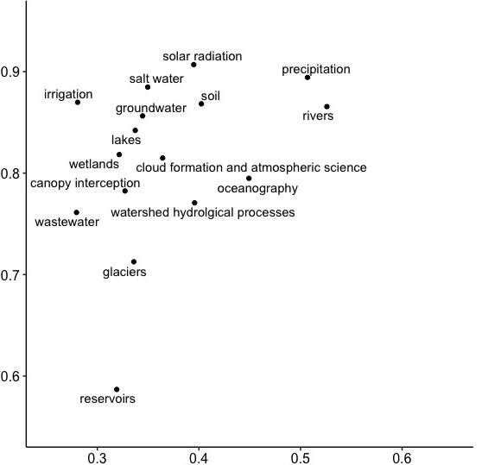
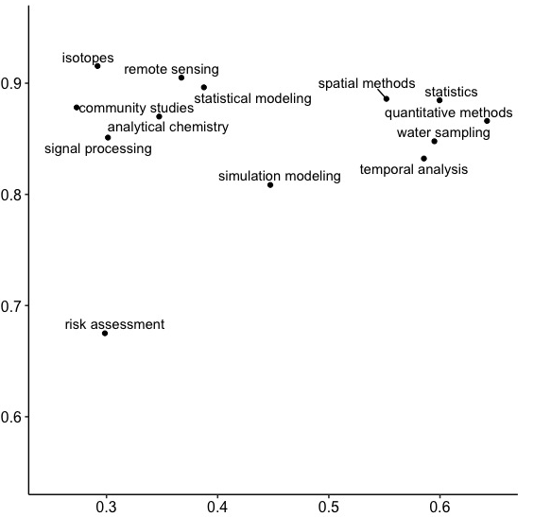
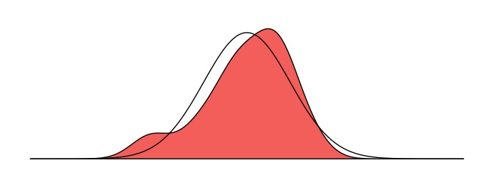
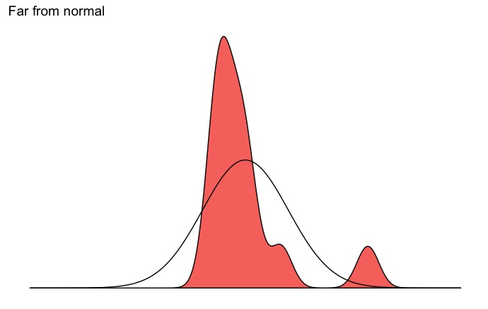
Normality describes how close a topic’s distribution is to the standard normal distribution
Components of the water budget
Research methods
Close to normal
Normality across countries
Far from normal
Normality across documents

